Slide 1
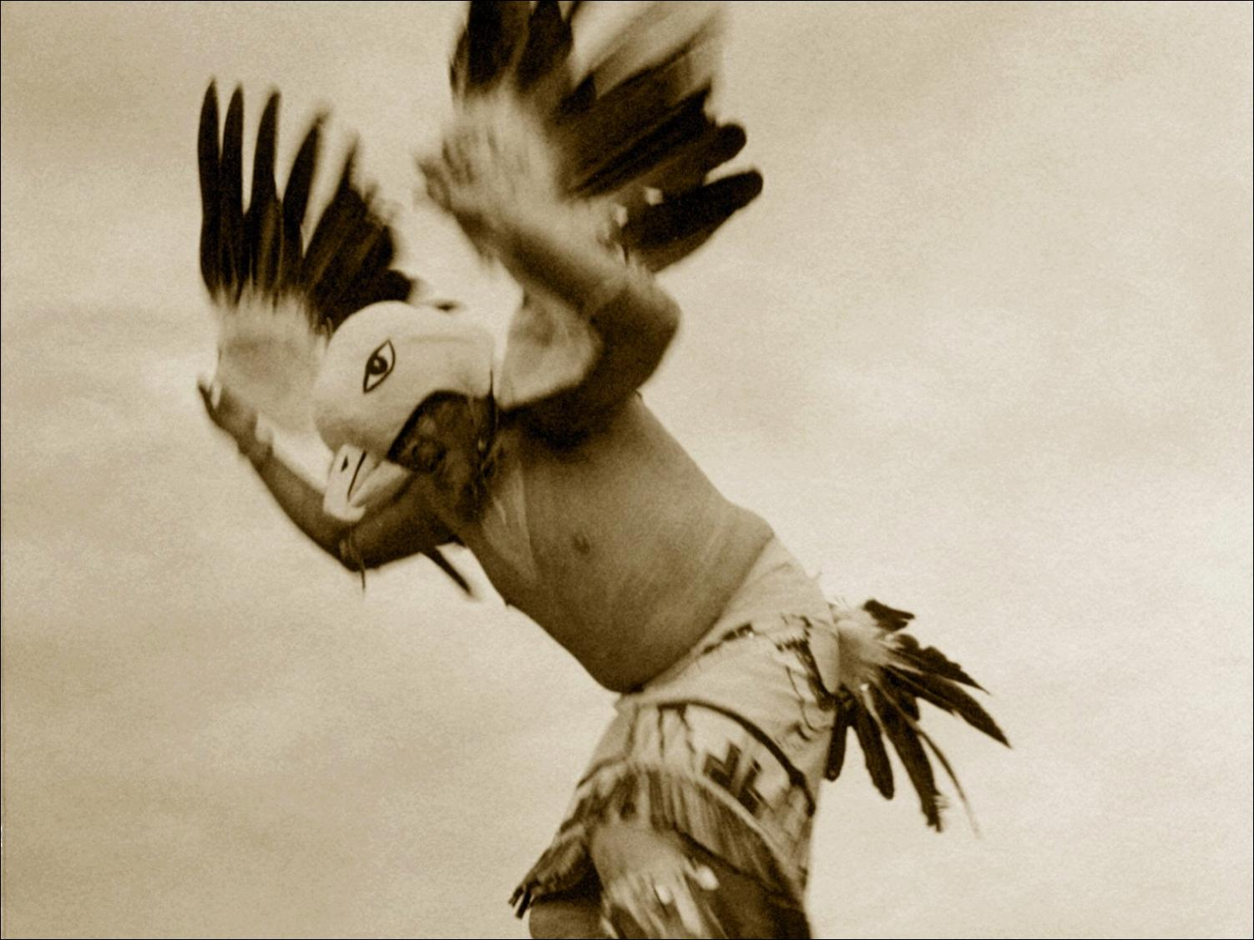
Native American Literature
30,000BC - 1730

Slide 2
Historical Context
N.A.’s have been in America 30 times longer than Europeans.
N. A.’s befriended the first Europeans and instructed them in agriculture and woodcraft.
If not for the help of N.A.’s, the Europeans may not have survived the cold winters.

Slide 3
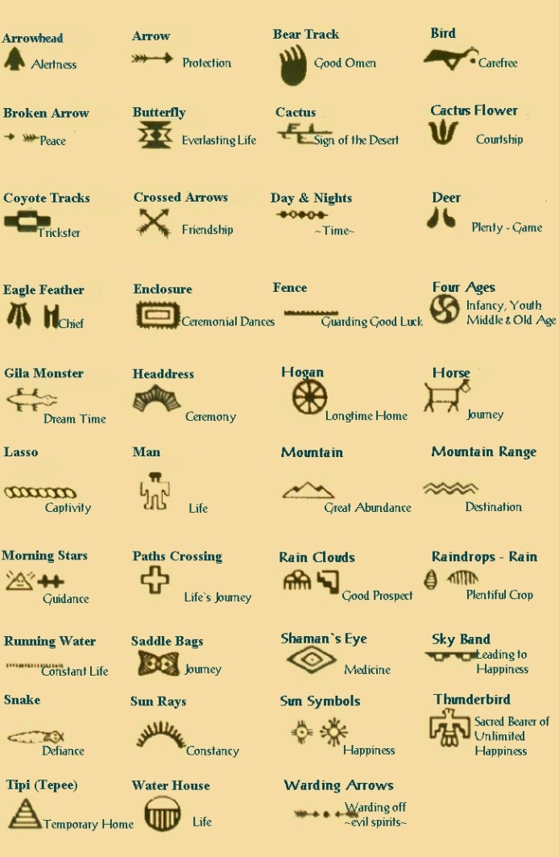
Recorded in pictographs, or symbols conveying ideas.

Slide 4
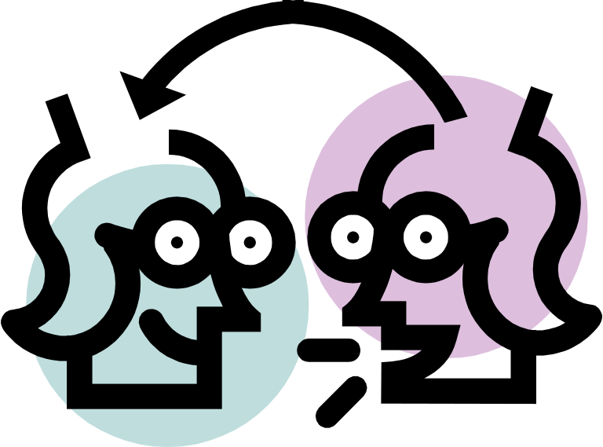
No fixed versions exist because of the oral tradition. Stories change over time with each speaker.

Slide 5

Language is poetic and moving.

Slide 6
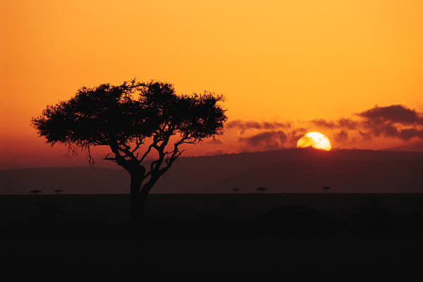
Interaction with nature is portrayed.

Slide 7
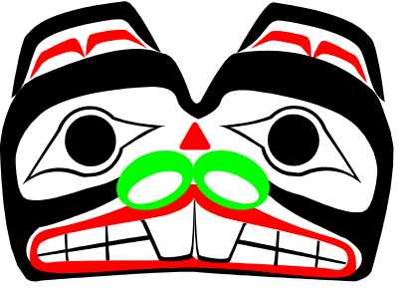
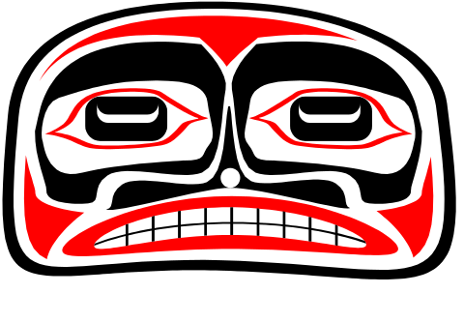
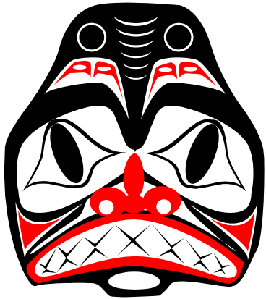
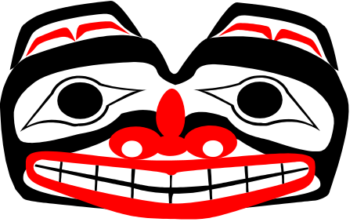
Related to tribal knowledge, customs, and rituals.

Slide 8

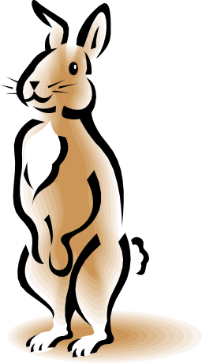
Trickster stories illustrate culturally appropriate behavior and explain the origins of some feature of the natural world.

Slide 9
What happened next?
The arrival of the white settlers resulted in almost the complete destruction of N. A. societies.
N. A.’s were forced to learn the white man’s ways of survival.
N. A.’s were in danger of losing their identity, language, and traditions.
Some N. A.’s and whites are credited for keeping the heritage alive.

Slide 10
Native American Literature: Cultural Diversity
At time of Columbus, 350 distinct languages existed in North America
Thousands of distinct cultural groups existed as well.
No single Native American culture or literature.
so

Slide 11

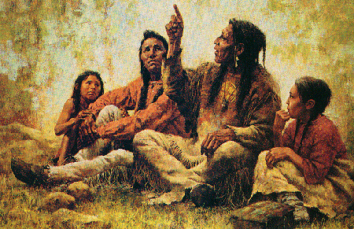
What are the characteristics of Native American Literature?
Oral history:
Good speakers valued in many tribes because of tradition of participatory democracy
Stories handed down through the oral tradition

Slide 12
Characteristics of Native American Literature
Oral Tradition
Storytelling: primary means of communicating and teaching about the physical world, social order, appropriate behavior, human nature, and the problem of good vs. evil.
Repetition is a common characteristic
Ritual beginnings and endings
Use of archaic language
Terse writing style

Slide 13
Additional Characteristics of Native American Literature
Explains beliefs about the nature of the physical world. Example: how did the world come to be?
Takes place in primal world or pre-civilization.
Beings are animal spirits in more or less human form: monsters, confusions of nature, etc.
Mythic age flows into age of transformation (legends), which flows into historical time (real heroes)

Slide 14
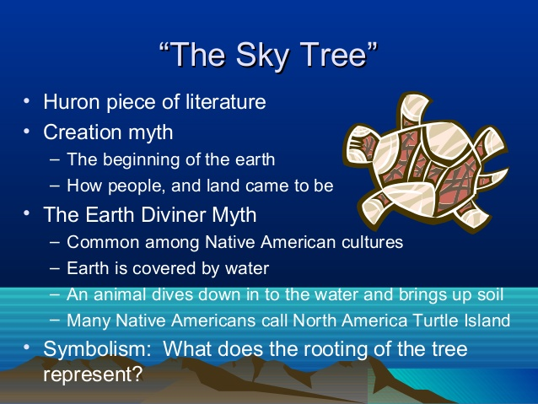

Slide 15
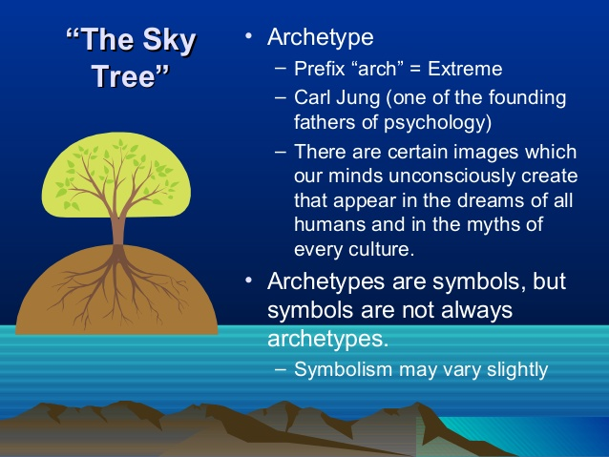

Slide 16
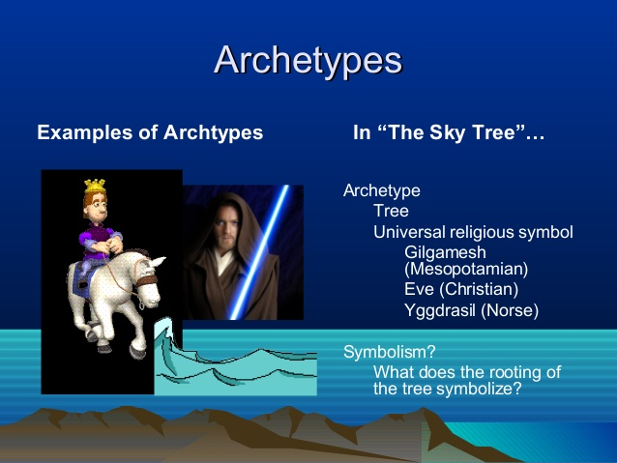

Slide 17
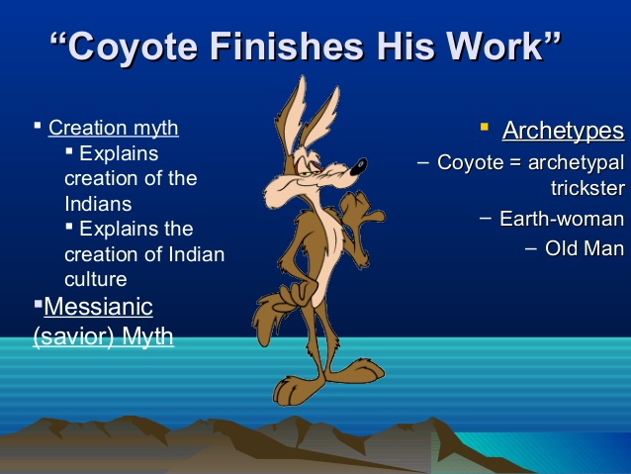

Slide 18
